Slide 1
Jonathan Liebenau
London School of Economics comments on innovation in China & the direction of influence
The 5th China-UK Innovation & Development Forum
20 October 2020

Slide 2
Japan was different
Individual firms applying American innovation practices routinely, systematically & with rigor: ‘just-in-time’ [JIT] & advanced supply chain informatics; consultation & feedback; sympathetic architecture; robotics
  Lead by automobile firms (Nissan, Toyota, specialist suppliers, etc.)
  Quickly adopted through keiretsu manufacturers (Mitsubishi, Sumitomo, Mitsui, etc.)
  Effectively used by consumer electronics firms (Sony, Sanyo, Panasonic)
National policy fostered by clear goals (e.g. technology transfer, export-led growth) coordinated & ‘nudged’ by institutions (e.g. Ministry of International Trade & Industry [MITI])
  ‘patient capital’, export guarantees, long-term planning (also led to accusations of ‘dumping’, uncompetitive state aid & other aggressive practices)
Notes:
While many see this as uniquely Chinese, its roots are deep and resemble the ways in which Japan became a technology leader by institutionalising new practices in the 1970s & 80s. In the talk I will provide a comparison with Japan and the institutions that make up the Chinese innovation ‘infrastructure’. This includes their national innovation policy but also their approaches to standards & IP, the mechanisms of direct finance and the adaptations of state owned enterprises. I will also deal with a variety of other incentives to promote innovation systematically.

Slide 3
China is also ‘different’ (viz. Japan)
Key learnings from Japan along with recent American experiences
Where Japan experimented at the level of Nissan shopfloor ‘teams’, China experimented at the level of the sector nationally (& took advantage of their ‘population dividend’)
  Investment diversification promoted variety
Coincided with boom in university education, half of which in engineering related degree programmes (the ‘engineering dividend’)
Controlled liberalization of labour markets
Fostered transfer of technology through European & American MNCs, aggressive copying, strategic acquisitions (ex. Sanyo & GE Appliances [Haier], Kuka [Midea], IBM PC [Lenovo], etc.

Slide 4
Distinct innovation practice “a”:
‘Online Interactive Innovation’ developed by Xiaomi
Xiaomi attracts and converts customers to be interactive users (IUs), then the firm’s employees organize some enthusiastic and voluntary IUs as participative fans (PFs) to help to attract and interact with millions of IUs in the online communities, who provide millions of suggests, comments and complaints.
Employees supervise PFs to collect, reply, evaluate, screen & adopt valuable suggestions to improve the functions of products, a main source of R&D ideas, boosts patent applications & shipments
Ideas seeded by Apple, Amazon, etc., scaled & refined, then fed back

Slide 5
Distinct innovation practice ”b”
Corporate Governance
Fama (1980) argued that the separation of ownership & management is efficient for corporate governance; Agency theory leads us to believe that principal-agent problems can be mitigated by stock options for managers. But principal-principal problems often appear
Employee stock ownership plans (ESOP) considered an efficient way to solve both principal-agent & principal-principal problems
What relationship between ESOP and innovation especially patenting?

Slide 6
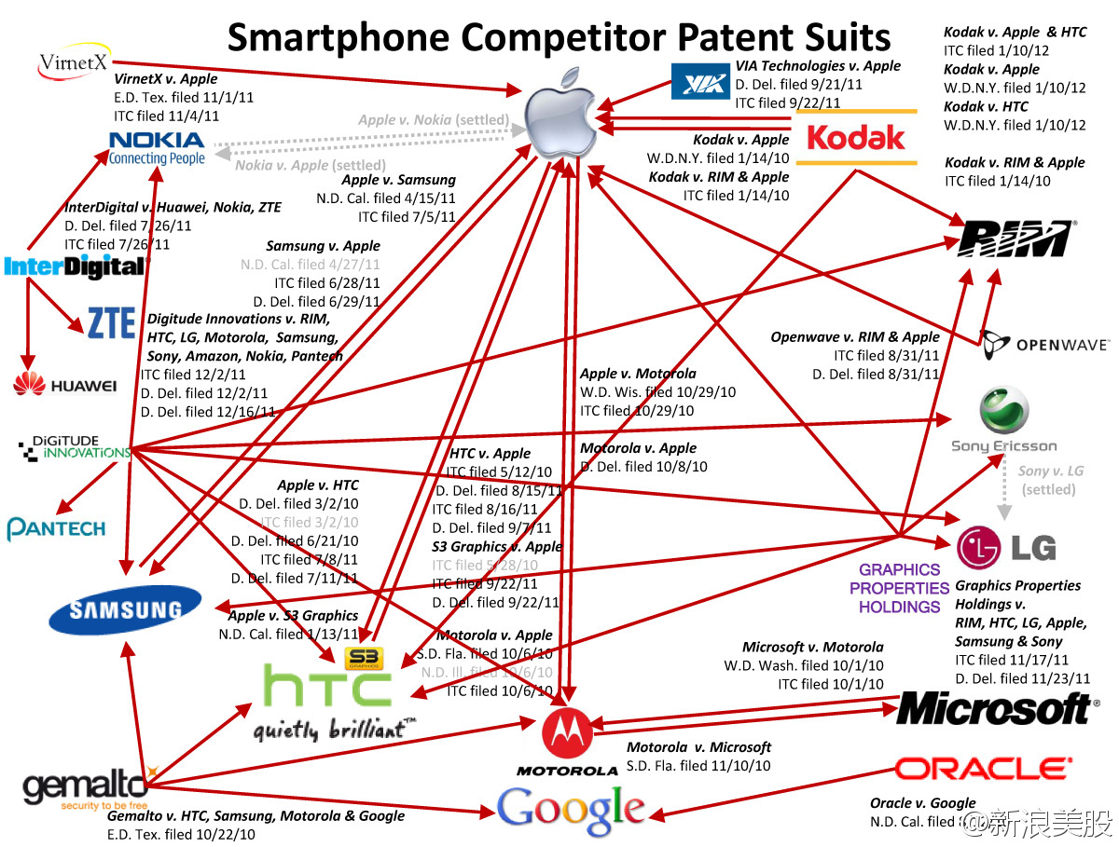
patent wars among smartphone firms
The game is also changing

Slide 7
Distinct innovation practices ‘c’
Platform innovations
Platform for e-cmmerce: Alibaba, Jidong, Meituan, Didi and Xiaomi
Platform for social: Tencent, Dingding of Aligroup
Platform for fans and new retailing: Xiaomi
Platform for IoT: Xiaomi, Huawei and Haier
Platform for transportation of passengers: Didi
Platform for transportation of goods: Transfar

Slide 8
Platform innovation: Transfar
Transfar -- platform for logistics & trucks
30 million truck drivers delivered 80% of goods domestically 2018
“Road Harbors” connect trucks & goods, providing services to all stakeholders; market-making
Provides fuel, hospitality, etc. (through concessions)

Slide 9
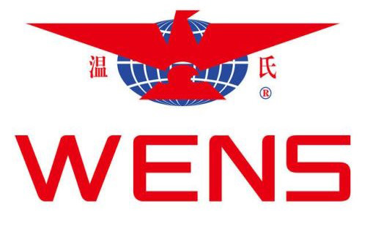
Platform innovation: WENS
Platform for livestock production (chickens & pigs)
Uses farmers’ land, infrastructure & skills
Provides animal stock (chicks & piglets), feed, medication & other consumables
Continuous services:
  Expertise
  Coordination
  Monitoring/surveillance
Arranges transport to abattoir (but does not own them, package, market, distribute or brand meat)

Slide 10
Huawei’s Innovation in Management
Huawei paid more than 1% of annual revenue to consulting firms especially in USA and Europe i.e. >US$5 billion
  IBM: ‘Integrated Product Development’; leadership & team mgt. from 1999
  Hay Consulting: HRM systems
Lean manufacturing from Toyota
Quality control from Toyota and Nissan
Security from Siemens
Notes:
About 80 thousands employees share the ownership of Huawei. The founder of Huawei has only 1.4% of the total profit. So, he likes to invest most of the profit to improve the business.

Slide 11
distinctions of a new innovation model
Scale & speed (differences in extent)
  Large scale institution-wide experimentation
  Rapid iteration
  Diffusion of mass customization
Differences in kind
  Massive online access to ideas (e.g. ‘OII’) integrated into business models
  Widespread applications of AI along with digitalization
  Major shift in governance for innovation (ESOP+)
  Routinization of knowledge sharing, exploitation of engineering capacity (beyond ‘open innovation’)
  Rapid deployment of integrated, ‘industry 4.0’ mechanisms & practices

Slide 12
diffusion, dynamics & other implications
Exemplary non-Chinese firms emulating
  Tesla viz. OII (they were already ahead with AI) & routine online updates
  Siemens & other German mfgs re-importing ‘industry 4.0’
  Facebook extending AI applications systemically
Next waves in China?
  IoT: Xiaomi, Huawei, Haier, Midea
  AI: Huawei, Alibaba, Tencent, Baidu
  5G and 6G: Huawei and ZTE
  Cloud computing: Alibaba, Tencent, Huawei
  Big data: all of the above
  Unmanned drones: DJI
  New energy vehicles: BYD, etc.
  Biotech: BGI
  Many new firms!

Slide 13
Conclusion
China caught the opportunity of mobile internet & surge in digital technologies & digital business models (some luck of timing, some ‘engineer dividend’, much coordination/finance)
Leading in mobile commerce, 5G, digital logistic & EVs, unmanned drones, etc.
Competing with US in AI, IoT, quantum computing, 6G, etc.
Still weak in many areas e.g. semiconductor design, pharmaceuticals
China cannot attract talent like US currently

